Slide 1

JAVA FULL STACK DEVELOPMENT INTERNSHIP REPORT
Presented by-
M Hemanth
19221125
BE. CSE

Slide 2

About the organization
Cognizant Technology Solutions Corporation is an American multinational information technology consulting and outsourcing company, headquartered in Teaneck, New Jersey.

Slide 3
Internship Overview
Domain-Full Stack
Duration-4 months
Technologies used
Frontend: React , Html , CSS , JS , TS , Bootstrap. Backend: Spring boot , java Database: SQL Testing tools: Sonar cube , jipkin , swagger , postman.

Slide 4
Project Description
ClaimInsight360 is a web-based Claims Analytics & Intelligence Platform designed for insurance carriers to analyze claims performance, detect trends, calculate KPIs, predict fraud/denials, monitor adjuster productivity, perform root-cause analysis, and provide real-time operational visibility into claims portfolios. It aggregates claims, policy, customer, financial, and external data to generate insights supporting claims managers, analysts, actuaries, and executives.
Implementable using Java Spring Boot/ASP.NET Core, Angular/React with relational DB + optional data mart.

Slide 5
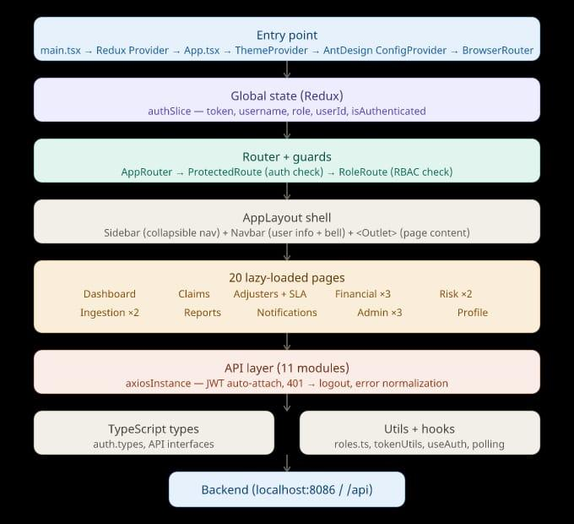
Working flow

Slide 6
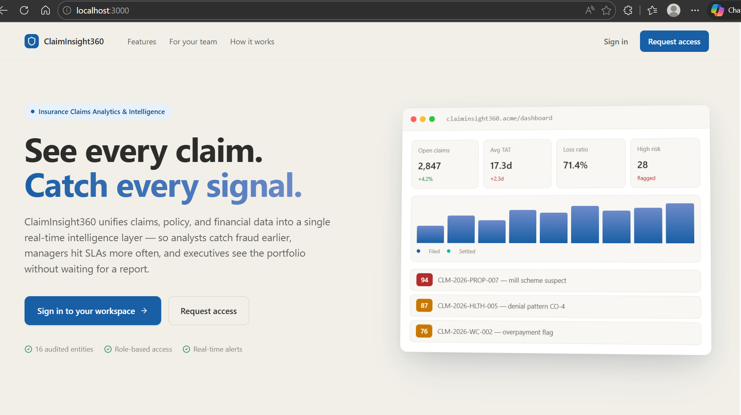
Landing Page

Slide 7
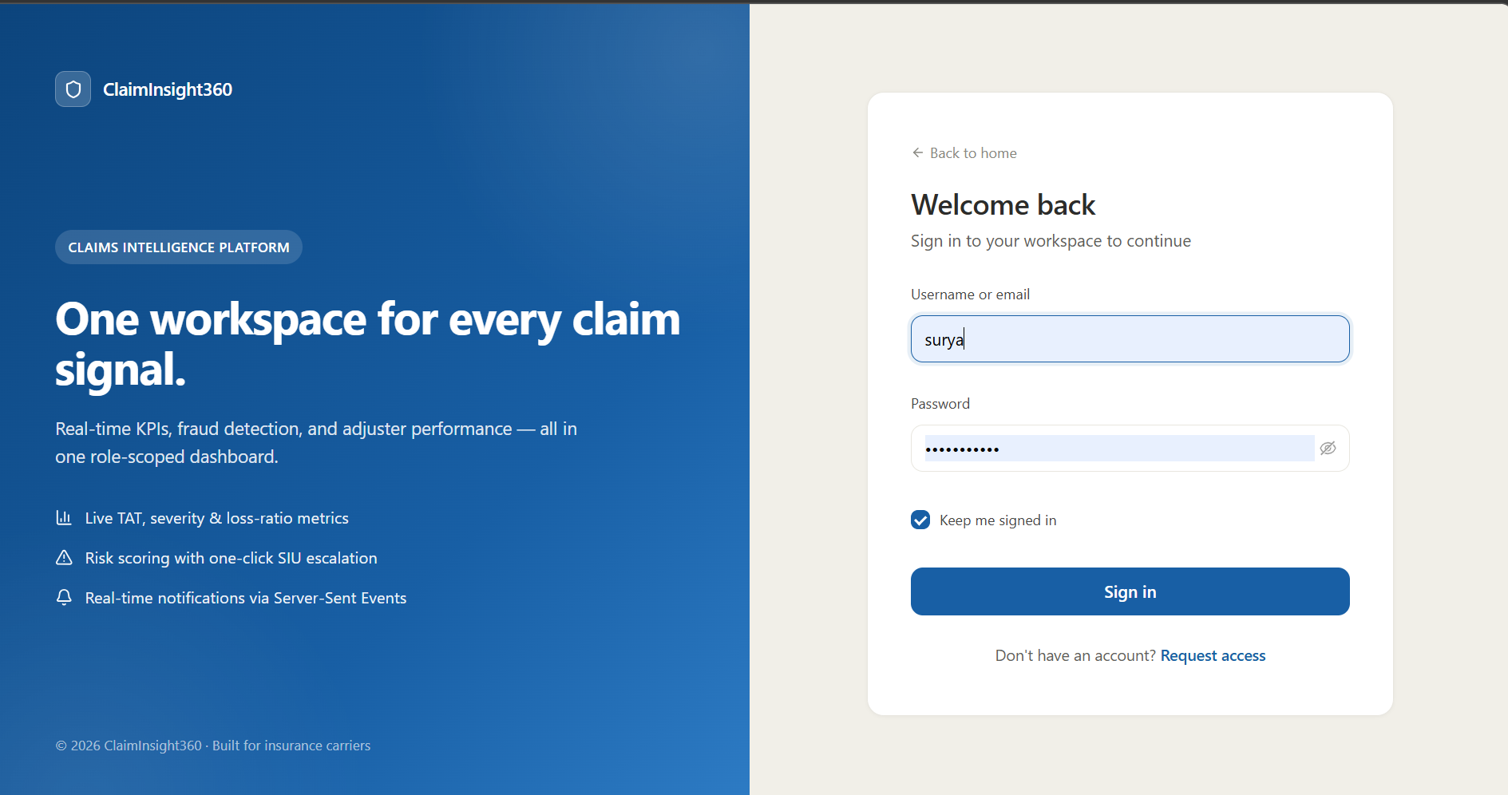
Sign in Page

Slide 8
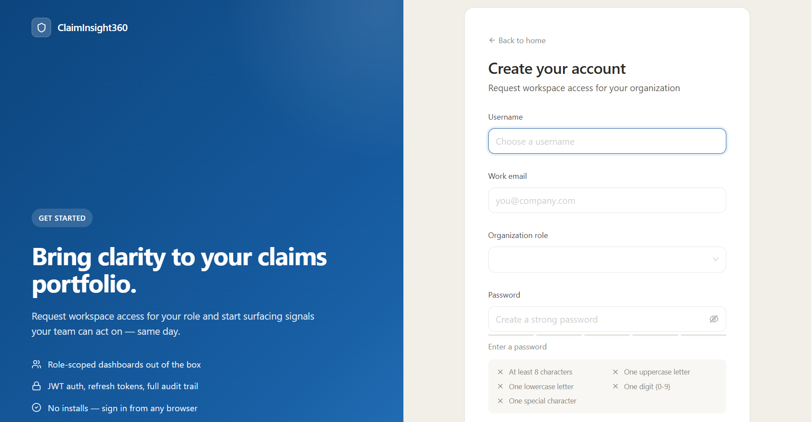
Page for New role

Slide 9
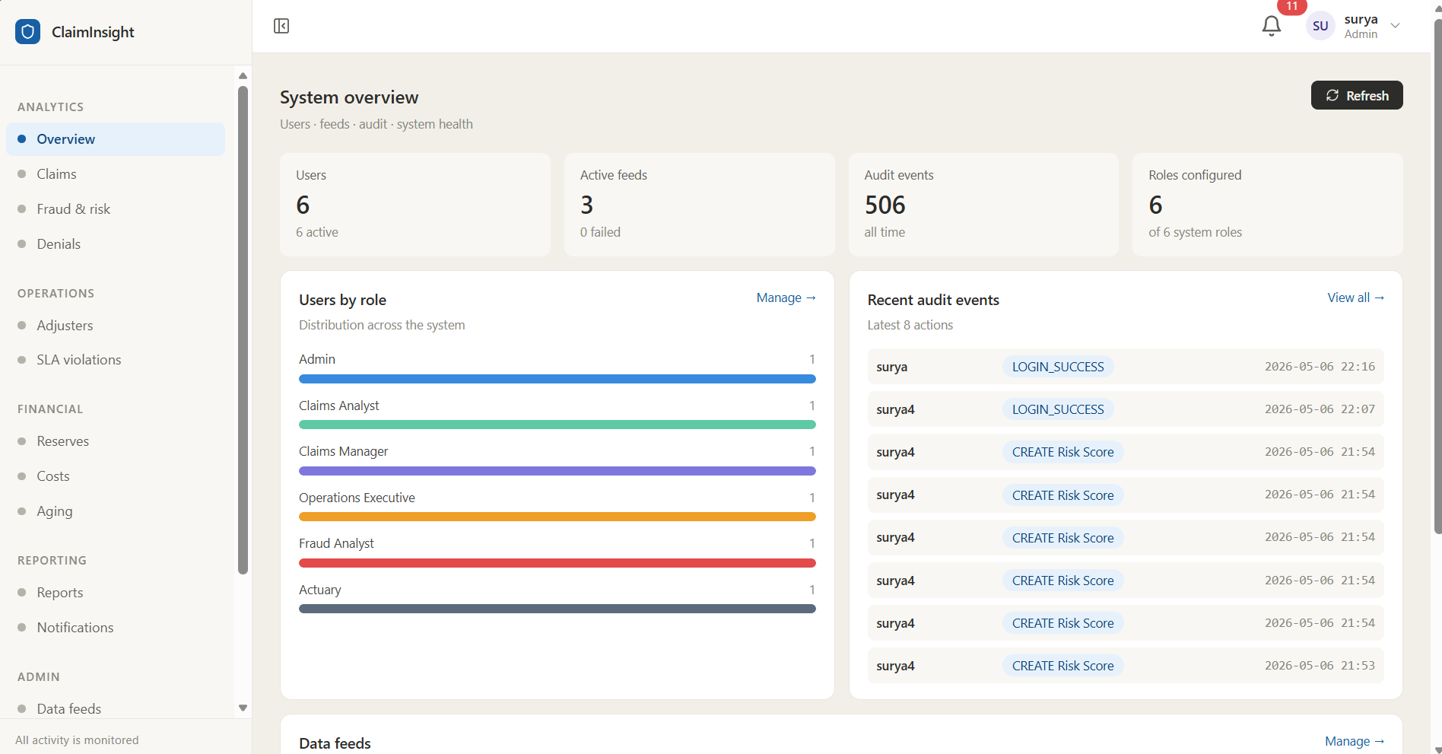
Admin

Slide 10
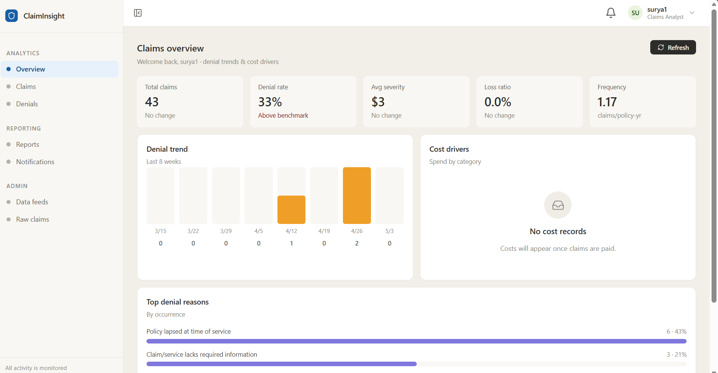
Claim Analyst

Slide 11
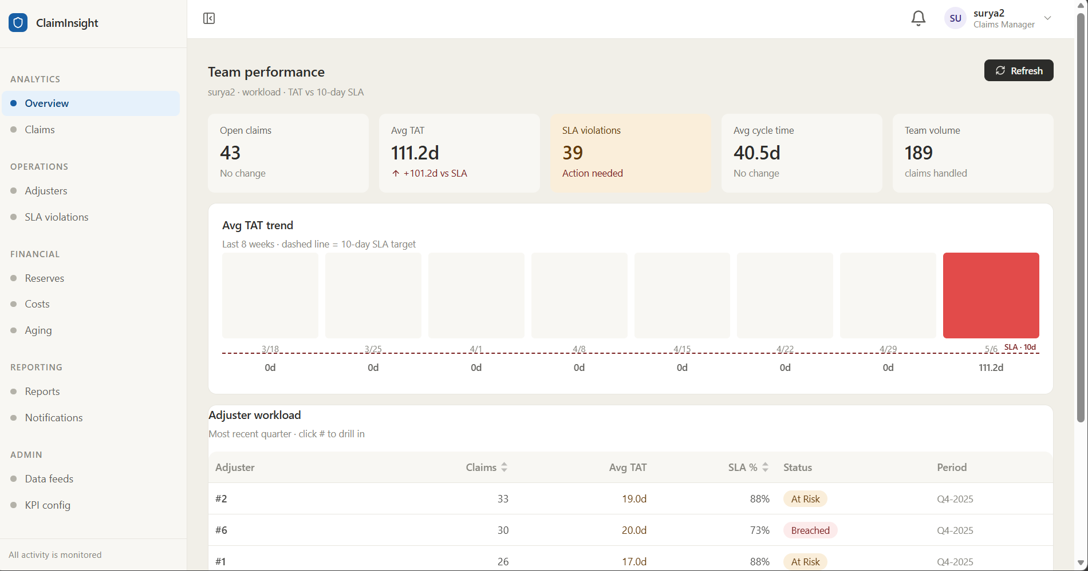
Claims Manager

Slide 12
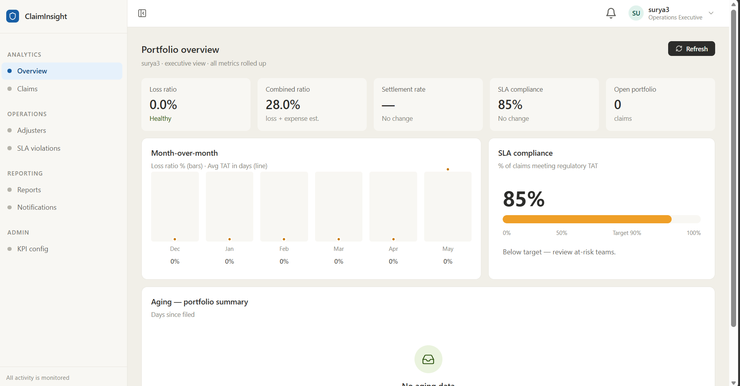
Operations Executive

Slide 13
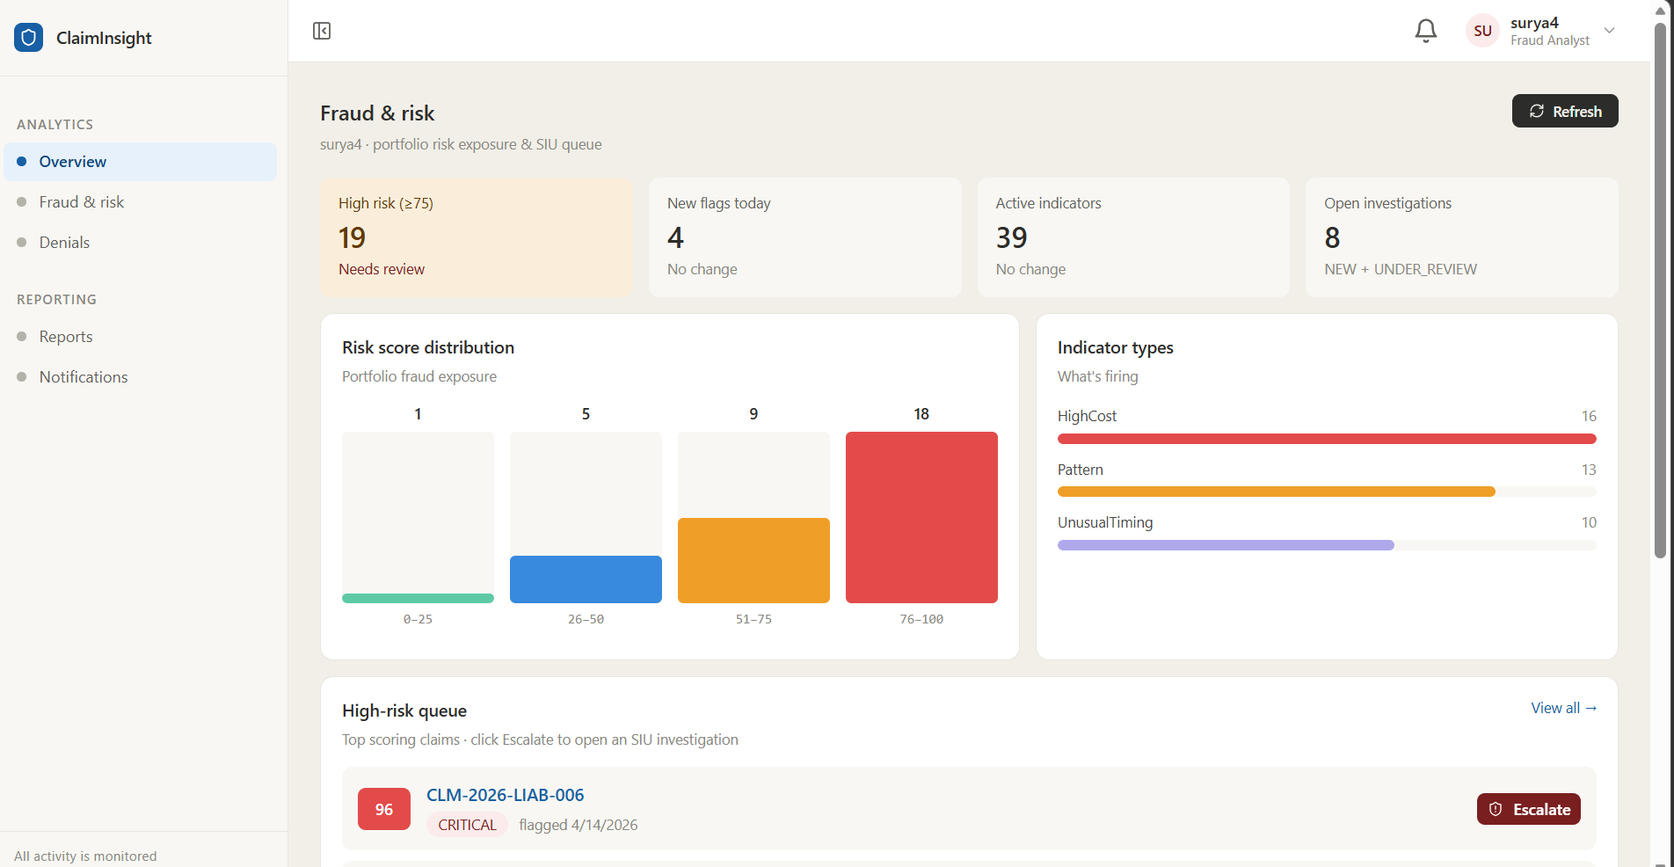
Fraud Analyst

Slide 14
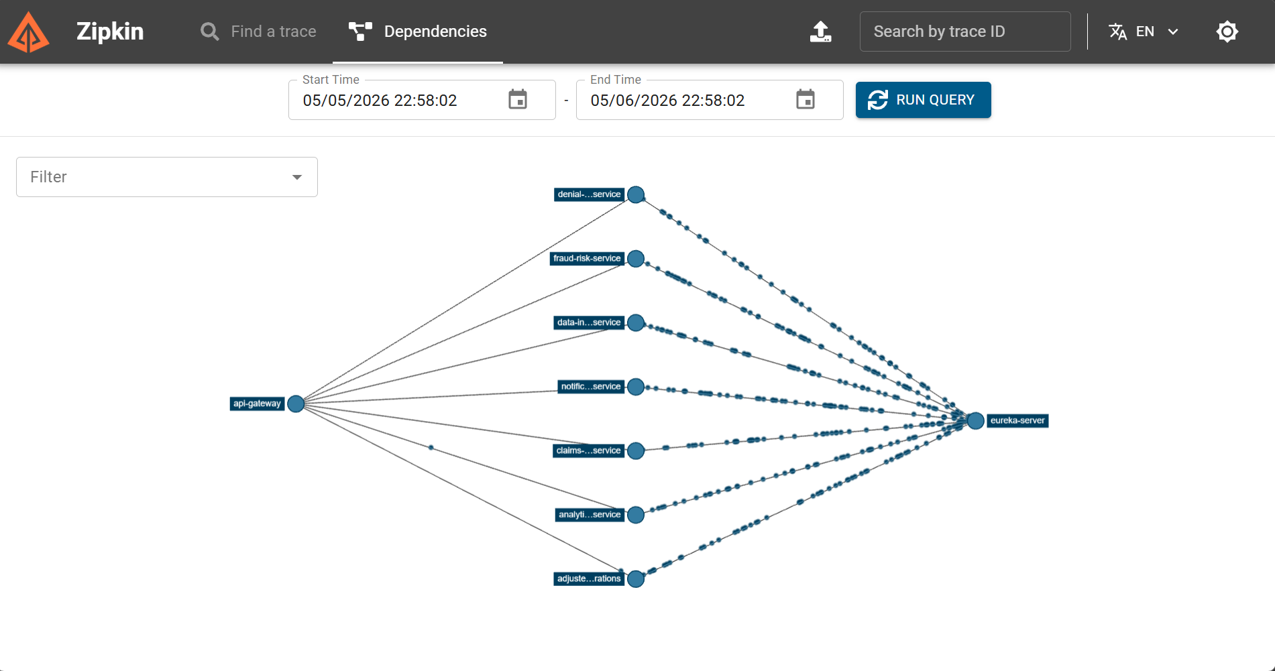
Zipkin

Slide 15
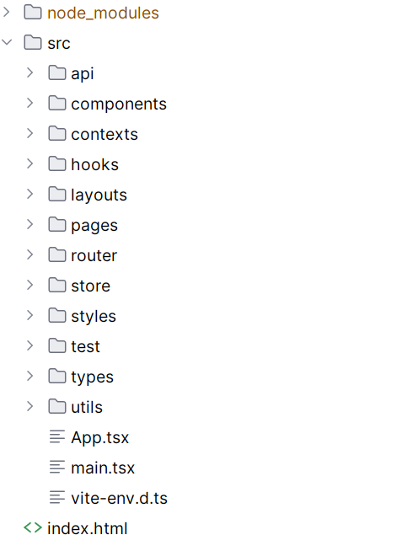
Fraud Analyst
Frontend Flow

Slide 16
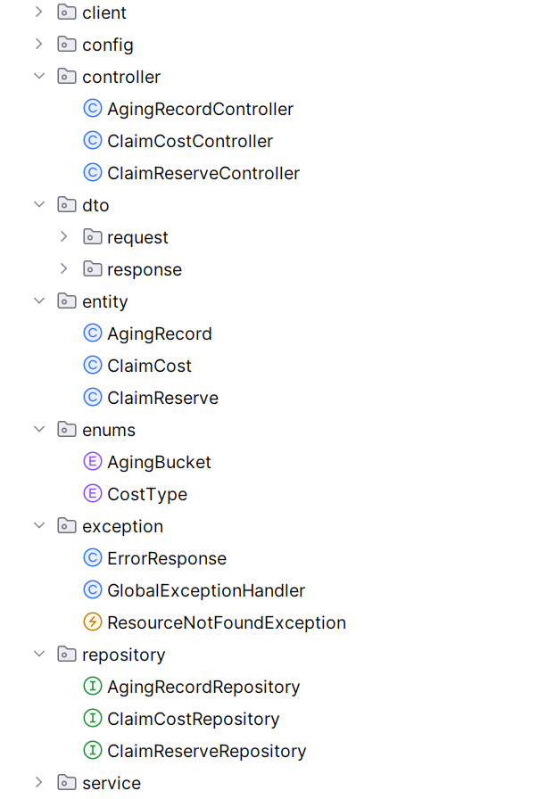
Fraud Analyst

